Slide 1

Algorithms and Data Structures 1 CS 0445
Fall 2023
Applications of ADT Stack
Sherif Khattab
ksm73@pitt.edu
(Slides are adapted from Textbook and Dr. Ramirez’s CS 0445 slides.)

Slide 2
Announcements
Upcoming Deadlines:
Homework 5: Tuesday 10/3 @ 11:59 pm
Lab 3: Friday 10/6 @ 11:59 pm
Programming Assignment 2: Friday 10/20 @ 11:59 pm
Midterm Exam next week
Th 10/12
in-person, closed-book, pencil-and-paper
Study guide and old exams + review video will be posted on Canvas

Slide 3
ADT Stack Applications
Parsing Algebraic Expressions

Slide 4
Processing Algebraic Expressions
Algebraic expressions can take different forms:
Infix: binary operator appears between operands: a + b
Prefix: binary operator appears before operands: + a b
Postfix: binary operator appears after operands: a b +
Prefix and Postfix forms easy to evaluate by a computer
no parentheses needed
Postfix expression: no need for operator precedence rules

Slide 5
Our Plan for Parsing
Check if infix expression is balanced
Convert infix expression to postfix
Evaluate postfix expression

Slide 6
Step 1: Balance Checking an Infix Algebraic Expression
initialize an empty Stack
for each character in the input infix expression
if ‘(‘ → push to Stack
if ‘)’ → pop from stack and check
if a matching pair, continue
else (stack empty or not matching) → unbalanced
if stack not empty → unbalanced
else → balanced

Slide 7
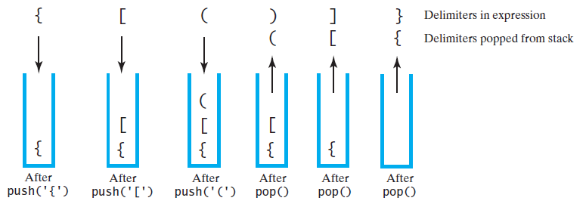
Balance Checking an Infix Algebraic Expression
The contents of a stack during the scan of an expression that contains the balanced delimiters { [ ( ) ] }
]
{
)
[
(
}

Slide 8
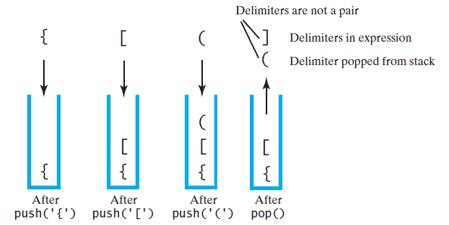
Unbalanced Expression: Case 1
The contents of a stack during the scan of an expression that contains the unbalanced delimiters { [ ( ] ) }
{
[
(
]

Slide 9
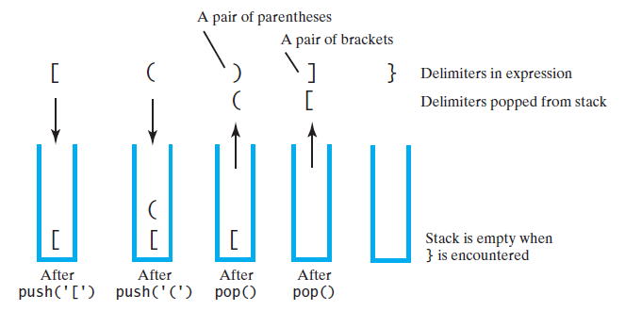
Unbalanced Expression: Case 2
The contents of a stack during the scan of an expression that contains the unbalanced delimiters [ ( ) ] }
]
[
(
)
}

Slide 10
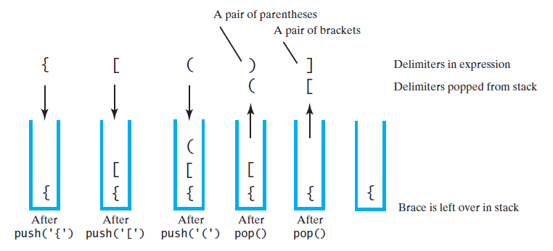
Unbalanced Expression: Case 3
The contents of a stack during the scan of an expression that contains the unbalanced delimiters { [ ( ) ]
)
{
[
(
]

Slide 11
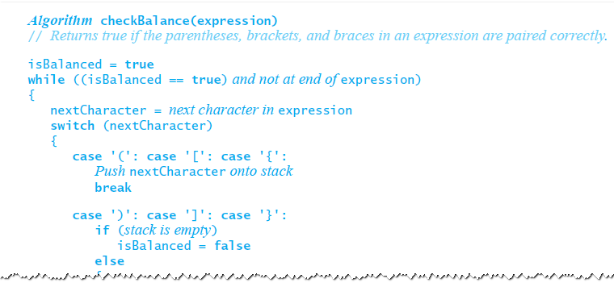
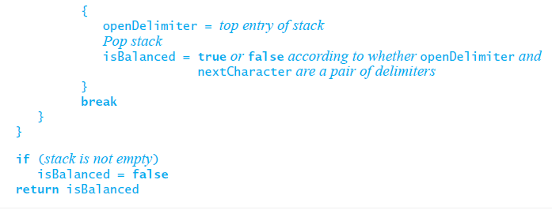
Processing Algebraic Expressions
Algorithm to check for balanced infix expression

Slide 12
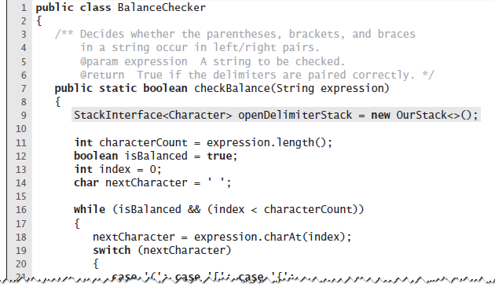
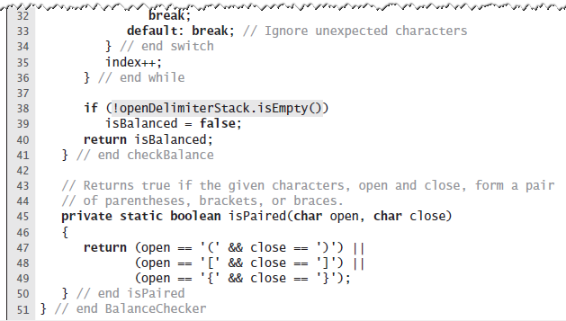
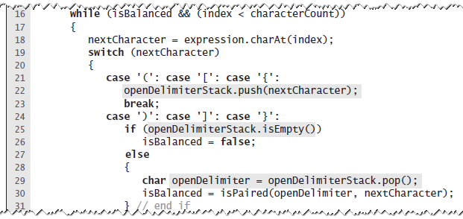
Java Implementation

Slide 13
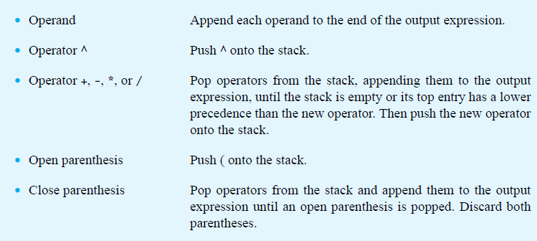
Step 2: Infix-to-postfix Conversion Algorithm
for each character in the input expression

Slide 14
Infix-to-postfix Conversion Algorithm
for each character in the input expression

Slide 15
Infix-to-postfix Conversion Algorithm
for each character in the input expression

Slide 16
Infix-to-postfix Conversion Algorithm
for each character in the input expression

Slide 17
Infix-to-postfix Conversion Algorithm
for each character in the input expression

Slide 18
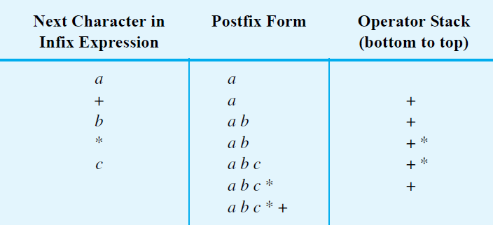
Infix to Postfix: Example 1
Converting the infix expression a + b * c to postfix form

Slide 19
Infix to Postfix: Example 1
Converting the infix expression a + b * c to postfix form

Slide 20
Infix to Postfix: Example 1
Converting the infix expression a + b * c to postfix form

Slide 21
Infix to Postfix: Example 1
Converting the infix expression a + b * c to postfix form

Slide 22
Infix to Postfix: Example 1
Converting the infix expression a + b * c to postfix form

Slide 23
Infix to Postfix: Example 1
Converting the infix expression a + b * c to postfix form

Slide 24
Infix to Postfix: Example 1
Converting the infix expression a + b * c to postfix form

Slide 25
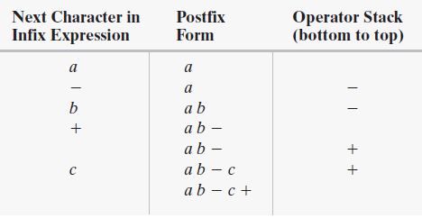
Example with Successive Operators with Same Precedence
Converting an infix expression to postfix form: a - b + c

Slide 26
Example with Successive Operators with Same Precedence
Converting an infix expression to postfix form: a - b + c

Slide 27
Example with Successive Operators with Same Precedence
Converting an infix expression to postfix form: a - b + c

Slide 28
Example with Successive Operators with Same Precedence
Converting an infix expression to postfix form: a - b + c

Slide 29
Example with Successive Operators with Same Precedence
Converting an infix expression to postfix form: a - b + c

Slide 30
Example with Successive Operators with Same Precedence
Converting an infix expression to postfix form: a - b + c

Slide 31
Example with Successive Operators with Same Precedence
Converting an infix expression to postfix form: a - b + c

Slide 32
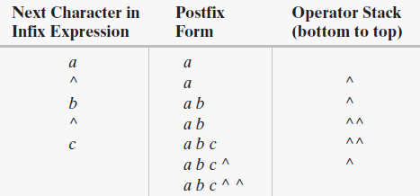
Another Example with Successive Operators with Same Precedence
Converting an infix expression to postfix form: a ^ b ^ c

Slide 33
Another Example with Successive Operators with Same Precedence
Converting an infix expression to postfix form: a ^ b ^ c

Slide 34
Another Example with Successive Operators with Same Precedence
Converting an infix expression to postfix form: a ^ b ^ c

Slide 35
Another Example with Successive Operators with Same Precedence
Converting an infix expression to postfix form: a ^ b ^ c

Slide 36
Another Example with Successive Operators with Same Precedence
Converting an infix expression to postfix form: a ^ b ^ c

Slide 37
Another Example with Successive Operators with Same Precedence
Converting an infix expression to postfix form: a ^ b ^ c

Slide 38
Another Example with Successive Operators with Same Precedence
Converting an infix expression to postfix form: a ^ b ^ c

Slide 39
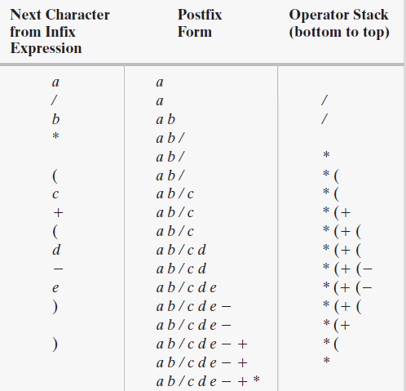
Infix to Postfix: Larger Example
The steps in converting the infix expression a / b * (c + (d - e)) to postfix form

Slide 40
Infix to Postfix: Larger Example
The steps in converting the infix expression a / b * (c + (d - e)) to postfix form

Slide 41
Infix to Postfix: Larger Example
The steps in converting the infix expression a / b * (c + (d - e)) to postfix form

Slide 42
Infix to Postfix: Larger Example
The steps in converting the infix expression a / b * (c + (d - e)) to postfix form

Slide 43
Infix to Postfix: Larger Example
The steps in converting the infix expression a / b * (c + (d - e)) to postfix form

Slide 44
Infix to Postfix: Larger Example
The steps in converting the infix expression a / b * (c + (d - e)) to postfix form

Slide 45
Infix to Postfix: Larger Example
The steps in converting the infix expression a / b * (c + (d - e)) to postfix form

Slide 46
Infix to Postfix: Larger Example
The steps in converting the infix expression a / b * (c + (d - e)) to postfix form

Slide 47
Infix to Postfix: Larger Example
The steps in converting the infix expression a / b * (c + (d - e)) to postfix form

Slide 48
Infix to Postfix: Larger Example
The steps in converting the infix expression a / b * (c + (d - e)) to postfix form

Slide 49
Infix to Postfix: Larger Example
The steps in converting the infix expression a / b * (c + (d - e)) to postfix form

Slide 50
Infix to Postfix: Larger Example
The steps in converting the infix expression a / b * (c + (d - e)) to postfix form

Slide 51
Infix to Postfix: Larger Example
The steps in converting the infix expression a / b * (c + (d - e)) to postfix form

Slide 52
Infix to Postfix: Larger Example
The steps in converting the infix expression a / b * (c + (d - e)) to postfix form

Slide 53
Infix to Postfix: Larger Example
The steps in converting the infix expression a / b * (c + (d - e)) to postfix form

Slide 54
Infix to Postfix: Larger Example
The steps in converting the infix expression a / b * (c + (d - e)) to postfix form

Slide 55
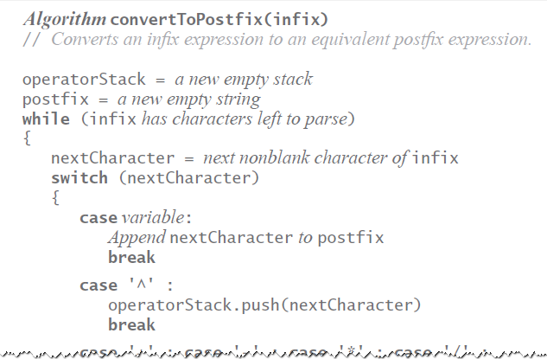
Infix-to-postfix Algorithm

Slide 56
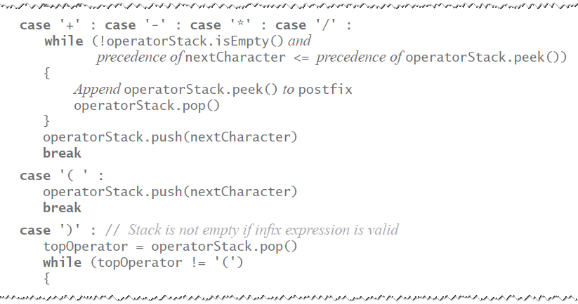
Infix-to-postfix Algorithm

Slide 57
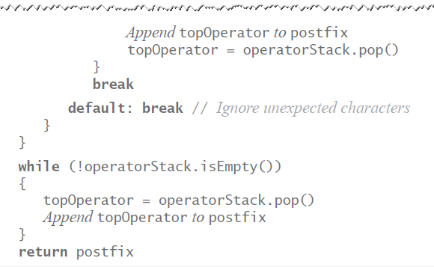
Infix-to-postfix Algorithm

Slide 58
Our Plan for Processing Algebraic Expressions
Check if input infix expression is balanced
Convert the expression from infix to postfix
Evaluate the postfix expression

Slide 59
Our Plan for Processing Algebraic Expressions
Check if input infix expression is balanced
Convert the expression from infix to postfix
Evaluate the postfix expression

Slide 60
Step 3: Evaluating Postfix Expressions
Initialize an empty Stack
for each character in postfix expression
if variable, push its value to Stack
if operator
pop second operand
pop first operand
apply operator to two operands
push result
Return the remaining value in Stack

Slide 61
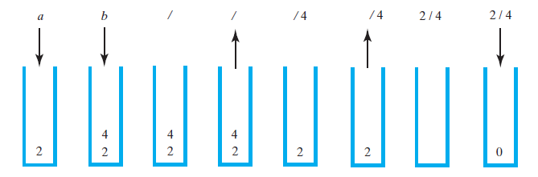
Step 3: Evaluating Postfix Expressions
The stack during the evaluation of the postfix expression
a b / when a is 2 and b is 4

Slide 62
Step 3: Evaluating Postfix Expressions
The stack during the evaluation of the postfix expression
a b / when a is 2 and b is 4

Slide 63
Step 3: Evaluating Postfix Expressions
The stack during the evaluation of the postfix expression
a b / when a is 2 and b is 4

Slide 64
Step 3: Evaluating Postfix Expressions
The stack during the evaluation of the postfix expression
a b / when a is 2 and b is 4

Slide 65
Step 3: Evaluating Postfix Expressions
The stack during the evaluation of the postfix expression
a b / when a is 2 and b is 4

Slide 66
Step 3: Evaluating Postfix Expressions
The stack during the evaluation of the postfix expression
a b / when a is 2 and b is 4

Slide 67
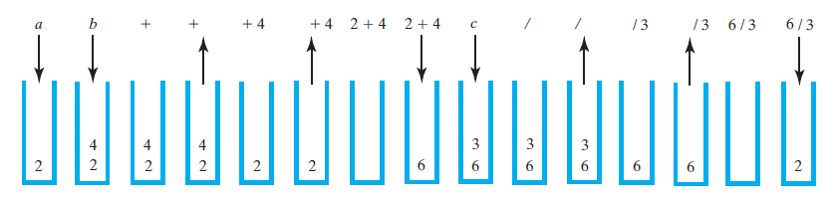
Evaluating Postfix Expressions: Example 2
The stack during the evaluation of the postfix expression a b + c / when a is 2, b is 4, and c is 3

Slide 68
Evaluating Postfix Expressions: Example 2
The stack during the evaluation of the postfix expression a b + c / when a is 2, b is 4, and c is 3

Slide 69
Evaluating Postfix Expressions: Example 2
The stack during the evaluation of the postfix expression a b + c / when a is 2, b is 4, and c is 3

Slide 70
Evaluating Postfix Expressions: Example 2
The stack during the evaluation of the postfix expression a b + c / when a is 2, b is 4, and c is 3

Slide 71
Evaluating Postfix Expressions: Example 2
The stack during the evaluation of the postfix expression a b + c / when a is 2, b is 4, and c is 3

Slide 72
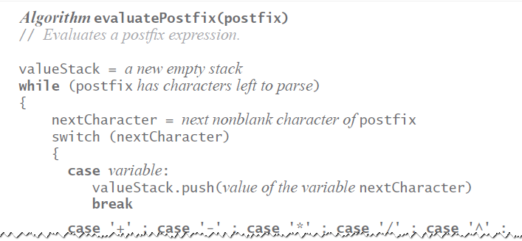
Evaluating Postfix Expressions
Algorithm for evaluating postfix expressions.

Slide 73
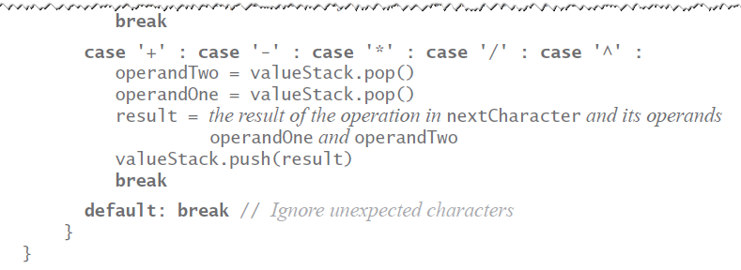
Evaluating Postfix Expressions
Algorithm for evaluating postfix expressions.

